Slide 1

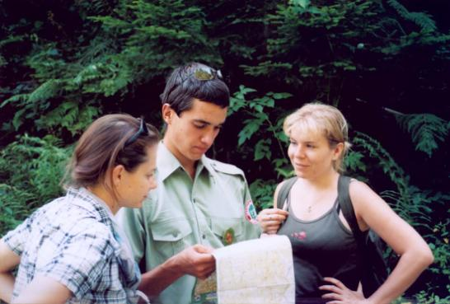
RANGER SERVICE
(Nature Guard)
in protected areas of the Czech Republic
Jiří Lehký - The Czech Ranger Association
PLA Beskydy Administration

Slide 2
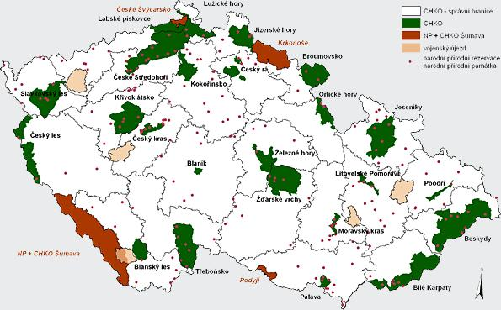
National parks & Protected landscape areas
of the Czech Republic

Slide 3
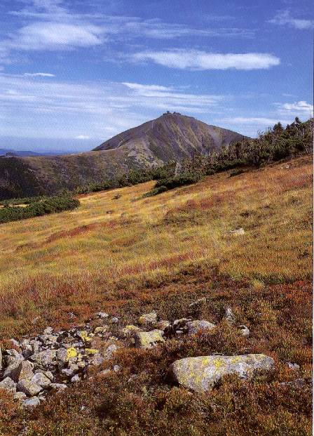

Krkonoše (The Giant Mountains ) National Park
the oldest NP (since 1963)
glacial relicts & endemites
corries, arcto-alpine tundra
peat-bogs

Slide 4
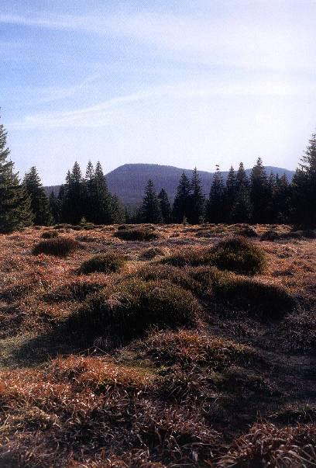

Šumava (The Bohemian Forest) National Park
the largest Czech NP
mountain landscape with spruce forests
glacial lakes, large peat-bogs

Slide 5
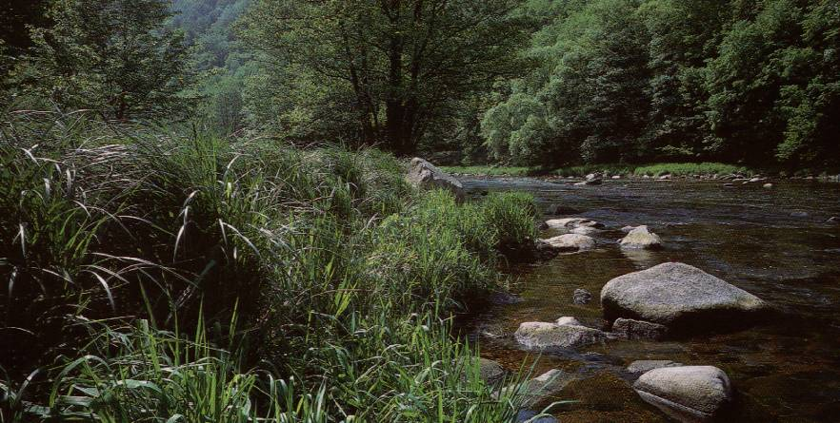

Podyjí (Dyje river) National Park
the smallest Czech NP
river canyon with meanders
heathlands, dry steppes

Slide 6
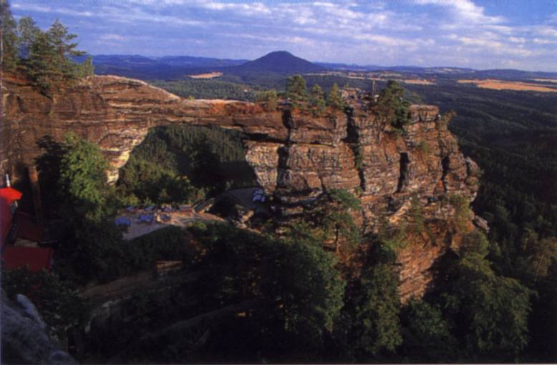

České Švýcarsko (The Bohemian Switzerland) National Park
deep river valley
bizarre sandstone rocks

Slide 7
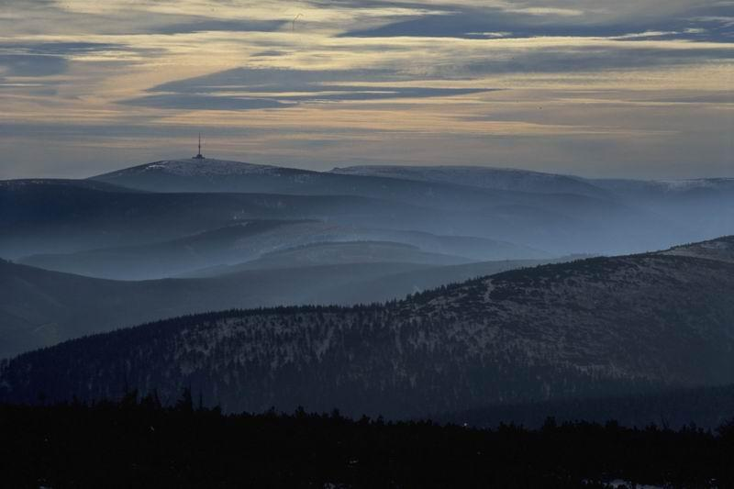

Jeseníky mts. Protected landscape area
subalpine meadows
autochtonous mountain spruce forest

Slide 8
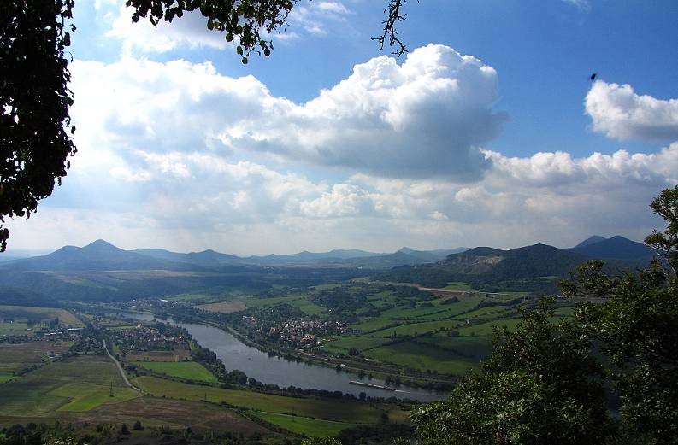
České středohoří Protected landscape area
landscape of volcanic cones and agricultural land
steppes, rocks, oak and oak-hornbeam forests
rich species diversity

Slide 9

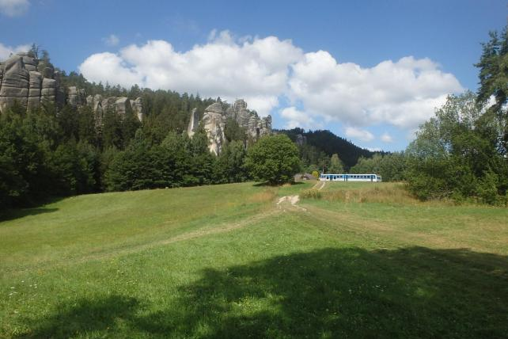
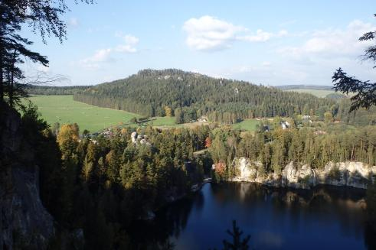
Broumovsko Protected landscape area
The largest rock city in Central Europe

Slide 10


System of state nature protection in the Czech Republic
or
Ministry of the Environment of the Czech Republic
Nature Conservation Agency of the Czech Republic
Regional authority
National park Administration
Protected landscape area Administration
Nature Guard
District council
Municipal authority

Slide 11
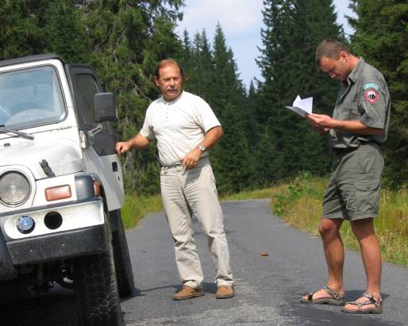
NATURE GUARD
by the Act No. 114/92 Coll. – on the Conservation of Nature and Landscape
„ The mission of Nature Guard shall be to check the observation of regulations pertaining to nature and landscape protection “

Slide 12

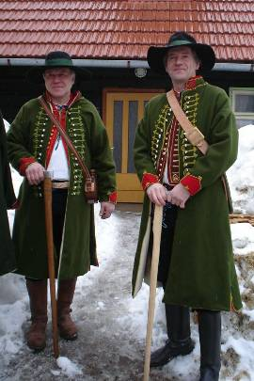
Long tradition …
Legal tradition since 1949
Today 4 kinds of special guards in CZ (forest guard, hunting guard, fishing guard, nature guard = rangers)
since 2000 – rangers have character of public officers§ 81 odst.2 ZOPK

Slide 13
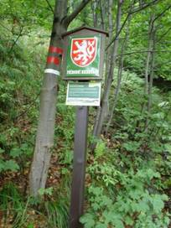
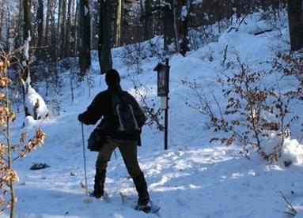
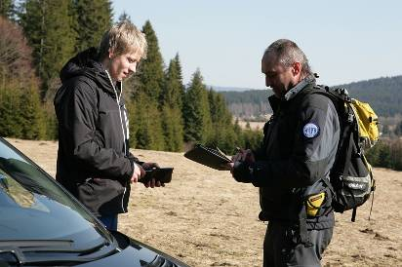
Activities of Rangers
1. Surveillance in Specially Protected Areas

Slide 14
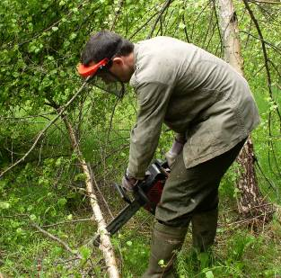
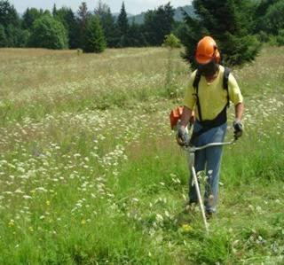
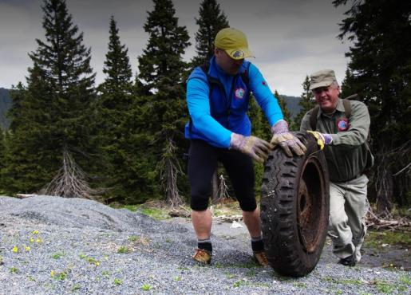
2. Management

Slide 15
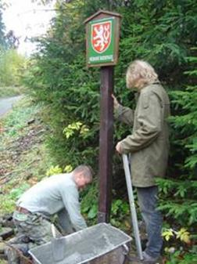
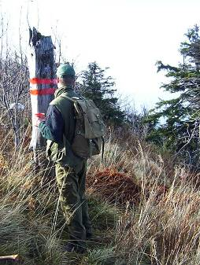
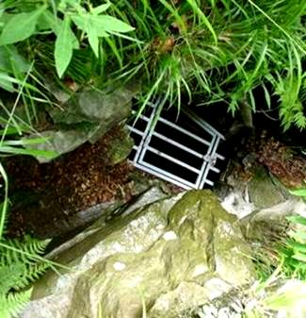
3. Marking of protected areas, installation of other terrain facilites

Slide 16
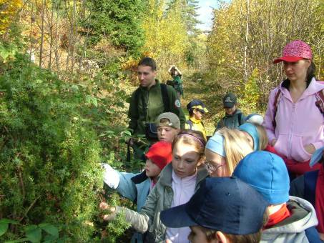
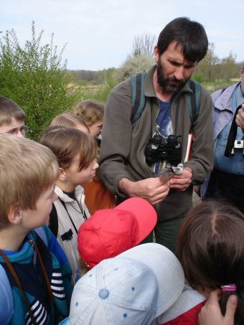
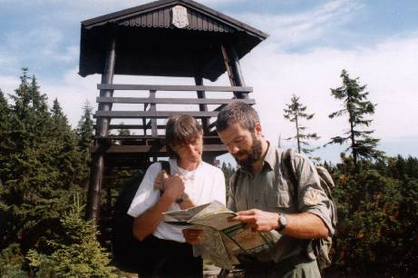
4. Education and interpretation

Slide 17
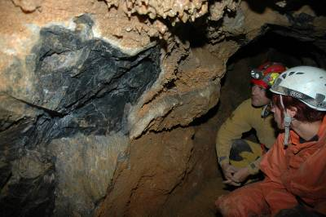
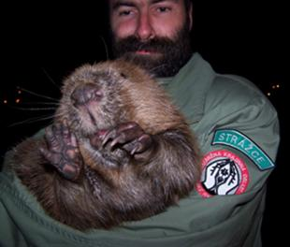
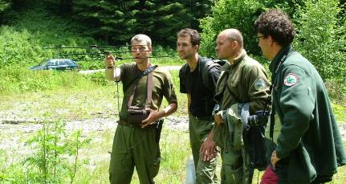
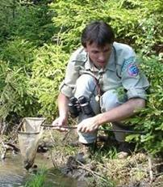
5. Monitoring of specially protected species

Slide 18
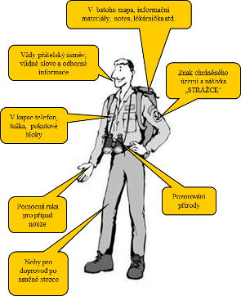
Who could be a Ranger (member of Nature Guard):
§ 81/ 3 Act N°114/92
- Czech citizen,
- age over 21
- blameless
- properly educated
- healthy

Slide 19
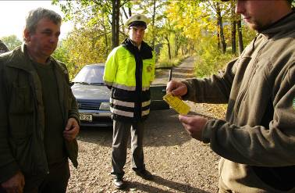
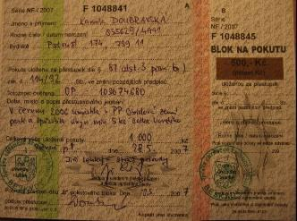
Competencies of a ranger:
§ 81 Act N°114/92
1) enter private property
2) check IDs of people who violate nature conservation regulations
3) impose and collect a fine on-the-spot
4) terminate (stop) disturbing activities in protected areas

Slide 20


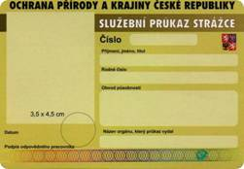
Duties of Rangers (by the Law):
§ 81 /a Act N°114/92
prove the ranger´s identity (badge, card)
supervise duties in nature protection
3) immediately report discoverd problems to the nature conservation authority or to the Police

Slide 21
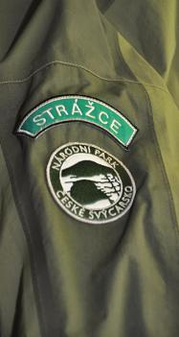
„Czech particularity“
1. Two „levels“ of rangers …
Ranger (Guard sensu stricto) – more legal power, character of a public officer
b) Reporter - usually biology specialists - people preparing for ranger service

Slide 22
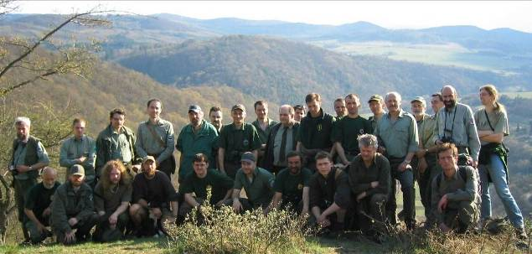
2. Many more voluntary rangers
there are about 500 rangers in NPs & PLAs + about 100 in regions
only 60 proffesionals (staff of NP & PLA Administrations)

Slide 23
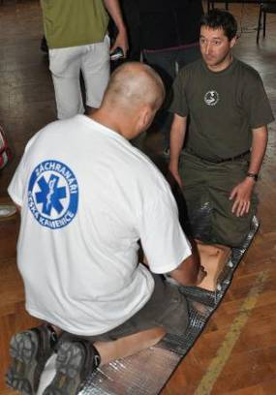
3. No central coordination and control of Nature Guard
low support by Ministry
no system of education
no methodology
no uniforms etc.

Slide 24
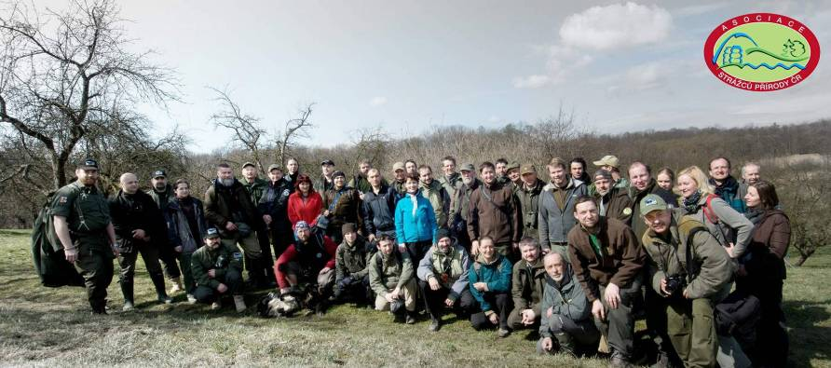
The Czech Ranger Association
Asociace strážců přírody ČR
founded in 1998
about 70 members

Slide 25
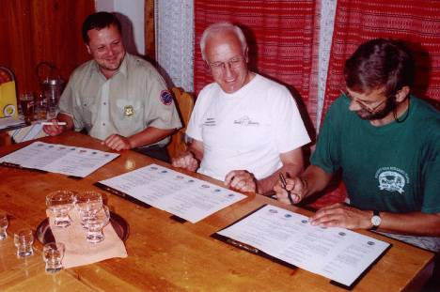
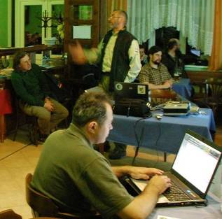

Partnership with Slovak Ranger Association
annual meetings of boards of both Associations
Meeting on the Border
common Vision for next 10 years

Slide 26
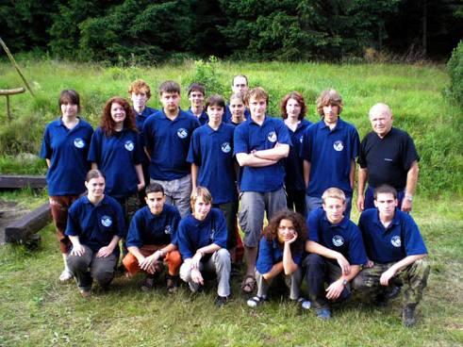

Junior Ranger Project
NP Sumava
NP Krkonose
NP Ceske Svycarsko
PLA Jizerske mts.
A „low-cost“ version (methodology) for Protected landscape areas is being prepared

Slide 27
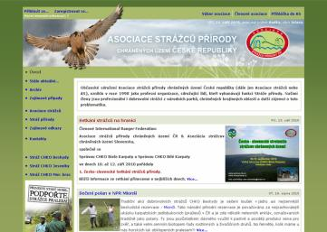
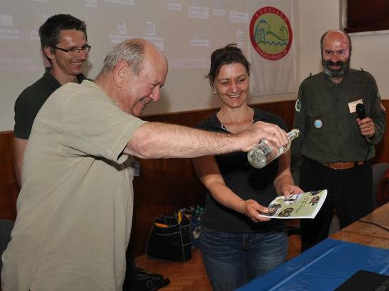


Handbook etc.
handbooks for Rangers
special training course (first-aid, communication, bird-criminality …)
web-site
www.strazprirody.cz

