Slide 1
Public Participation in Czech Republic
Petra Humlíčková
Arnika
September 2016

Slide 2
International law
The UNECE Convention on Aarhus Convention on access to information, public participation in decision-making and access to justice in environmental issues (the "Aarhus", 1998)
http://www.unece.org/env/pp/ratification.html
Parties to the Convention are all the Member States and the EU itself and 18 other states
CR: Communication from the Ministry of Foreign Affairs no. 124/2004 Coll.
Kyiv Protocol on Pollutant Release and Transfer Registers (PRTR) (Kiev, 2003)
http://www.prtr.net/

Slide 3
Aarhus Convention in CZ law
Art. 1, paragraph. 2 of the Constitution " The Czech Republic shall observe its obligations resulting from international law."
Art. 10 of the Constitution "Promulgated treaties, to the ratification of which Parliament has given its consent and by which the Czech Republic is bound, form a part of the legal order; if a treaty provides something other than that which a statute provides, the treaty shall apply."
terms of immediate application (direct application)
sufficient specificity
the ability to directly inferred from the provisions of treaty a specific and enforceable rights of individuals and legal persons to the state
AC is not directly applicable (case law SAC)
not specific
general obligations
national authorities are obliged to interpret national law in accordance with AC

Slide 4
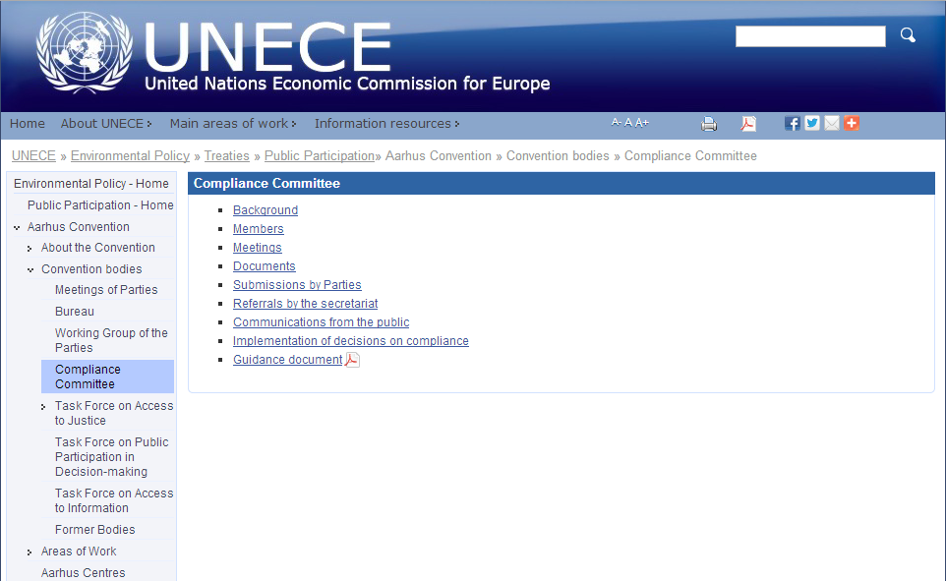
Aarhus Convention Compliance Committe
optional arrangements of a non-confrontational, non-judicial and consultative nature for reviewing compliance with the provisions of the Convention (Art. 15 AC)
http://www.unece.org/env/pp/cc.html

Slide 5
Cases Against Czech republic
4x
Complex (public participation, access to justice) ACCC/2010/50
EU ETS (National Investment Plan without public participation) ACCC/2012/70
Nuclear Power Plant Temelin (public participation discrimination of foreigners) ACCC/2012/71
Nuclear Power Plant Temelin (public participation, access to justice) ACCC/2012/71

Slide 6
Multi-layer decision making process
Building permit
SEA
Land use plan
EIA
Land use permit
IPPC

Slide 7
Main findings and Recommendations Accc/C/2010/50
restrictive interpretation of “the public concerned”
Members of the public concerned, including tenants and NGOs are allowed to effectively participate and submit comments throughout the decision-making procedure
fails to ensure that in the decision due account is taken of the outcome of PP
Multi-layer decision making (EIA separe, obligation to take into account outcomes of EIA in follow-up decisions)
legal standing NGO too limited + NGO review only procedural legality
NGOs have the right to access review any procedures and have standing to seek the review of also the substantive legality
review procedure to challenge the legality of EIA screening conclusions
Notes:
Through its restrictive interpretation of “the public concerned” in the phases
of the decision-making to permit activities subject to article 6 that come after the EIA
procedure, the system of the Party concerned fails to provide for effective public
participation during the whole decision-making process, and thus is not in compliance with
article 6, paragraph 3 of the Convention (see para. 70 above);
(b) By failing to impose a mandatory requirement that the opinions of the public
in the EIA procedure are taken into account in the subsequent stages of decision-making to
permit an activity subject to article 6, and by not providing opportunity for all members of
the public concerned to submit any comments, information, analyses or opinions relevant to
the proposed activities in those subsequent phases, the Party concerned fails to comply with
the requirement in article 6, paragraph 8, of the Convention to ensure that in the decision
due account is taken of the outcome of the public participation (see para. 71 above);
(c) The rights of NGOs meeting the requirements of article 2, paragraph 5, to
access review procedures regarding the final decisions permitting proposed activities, such
as building permits, are too limited, to the extent that the Party concerned fails to comply
with article 9, paragraph 2, of the Convention (see para. 78 above);
(d) By limiting the right of NGOs meeting the requirements of article 2,
paragraph 5, to seek review only of the procedural legality of decisions under article 6, the
Party concerned fails to comply with article 9, paragraph 2 of the Convention (see para. 81
above);
(e) To the extent that the EIA screening conclusions serve also as the
determination required under article 6, paragraph 1 (b), members of the public should have
access to a review procedure to challenge the legality of EIA screening conclusions. Since
this is not the case under Czech law, the Party concerned fails to comply with article 9,
paragraph 2, of the Convention (see para. 82 above);
(f) By not ensuring that members of the public are granted standing to challenge
the act of an operator (private person) or the omission of the relevant authority to enforce
the law when that operator exceeds some noise limits set by law, the Party concerned fails
to comply with article 9, paragraph 3. Similarly, in cases of land-use planning, by not
allowing members of the public to challenge an act, such as a land-use plan, issued by an
authority in contravention of urban and land-planning standards or other environmental
protection laws, the Party concerned fails to comply with article 9, paragraph 3, of the
Convention (see para. 85 above).

Slide 8
EU Infringement process
EU = Aarhus Convention Party
Directive 2011/92/EU on the assessment of the effects of certain public and private projects on the environment
Public participation + partly access to justice
Infringement – usinng the ACCC findings
Decision – building permit (not EIA)
Proceedings – all kind of multi-layer (not only EIA)
Binding EIA
Public participation + access to justice in follow-up procedures
EIA Act amendment (1. 4. 2015, No. 39/2015 Coll.)

Slide 9
EU law
towards EU
Regulation of the EP and Council Regulation no. 1367/2006 on the application of the provisions of the Aarhus Convention to Community institutions and bodies
No access to justice! (see ACCC/C/2008/32)
towards Member States
Directive of the EP and Council Directive 2001/42/EC of 27 June 2001 on the assessment of the effects of certain plans and programs on the environment (SEA)
EP and Council Directive 2011/92/EU of 13 December 2011 on the assessment of the effects of certain public and private projects on the environment (EIA)

Slide 10
Czech Constitutional Law
Charter of Fundamental Rights and Freedoms (no. 2/1993).
freedom of expression and right to information (Art. 17)
right of assemble and of associate (art. 19 and 20)
right to petition (art. 18)
right to participate in public affairs (Art. 21)
environmental protection and public health is a common reason for the realization of these rights <-> Art. 35 - everyone has the right to a favorable environment, information about the state of the environment

Slide 11
Czech Law on Public Participation
general arrangements
Act no. 500/2004 Coll., Administrative Procedure
special arrangements
Act no. 183/2006 Coll., Building Act
Act no. 114/1992 Coll., on nature and landscape protection
Act no. 100/2001 Coll., on assessment of environmental impacts
Act no. 76/2002 Coll., on integrated prevention
Act no. 254/2001 Coll., on waters

Slide 12
Participants Administrative Procedure Code (§ 27; 500/2004 Coll.)
Main - Essential
Parties (hereinafter the "Participant") are
the applicant
the proceedings ex officio the person who has the decision to establish, modify or terminate the right or obligation or declare that they have the right or obligation or not
Secondary
Participants are also other persons concerned, if they can be directly affected by the decision in their rights or duties
Participants are also persons, if laid down by special law
Special provisions:
Dispute if (s)he is participant
Participant who has been overlooked/forget

Slide 13
„New“ Public participation
Non-EIA
EIA - follow-up process
Owners
All rights
Tenants
no rights
NGOs
All envi NGOs
Aplly in 8 days+ request for information on the opening of proceedings
Limited standing
Court review – procedural rights only
Owners
All rights
Tenants/everyone
only cosultations - comments
NGOs
More than 3 years
More than 200 supporters
Aplly in 30 days
Full standing
Full court review
Suspensory effect
EIA
Everyone; each stage; comments – taken into account

Slide 14
Specific Public participation
Land Use Plans
Special Laws
Owners
All rights
Tenants
only cosultations – comments; no access to justice
NGOs
All envi NGOs
Limited standing
Court review – procedural rights only
Why? Building Act – if stated in special laws
Act on Landscape and Nature Protection
Act on Waters
Mining Act
IPPC Act
Environmental Liability Act
No Participation
Noise, nuclear (?), mining – same procedures

Slide 15
Participation
Which procedure?
it's a follow-up procedure?
Yes - according to EIA
No - according Building Act x Act on Nature and Landscape Protection, etc.
Am I an individual / community / NGO?
NGOs - EIA + Act on Nature and Landscape Protection
Individuals - Building Act
Municipalities - EIA + Building Act

Slide 16
Rights of participants in decision-making
right to participate in the proceedings
the right to be informed about a particular set of information - adequate, timely and effectively (including supporting documents for the decision and the final decision)
the right to have sufficient time to prepare for each phase
the right to participate at an early stage of the proceedings, when all options open,
right to make comments / objections
the right to a proper settlement of the comments / objections to the public in the final decision
the right to administrative and judicial review of decisions

Slide 17
Other ways of public participation in the administrative procedures
public, which is not in the position of a party:
- access to documents
- comments (land-use plans, EIA follow-up procedure)
- land-use plans - representative of the public - attendance at the public hearing (EIA, external emergency plans, land use plans)

Slide 18
Access to Justice

Slide 19
Aarhus Convention (art. 9)
Any person who considers that … has access to a review procedure before a court of law or another independent and impartial body established by law
request for information has been ignored, wrongfully refused, inadequately answered, or otherwise not dealt with in accordance with AC
to challenge the substantive and procedural legality of any decision, act or omission subject to the provisions of article 6 AC – Public Participation
members of the public have access to administrative or judicial procedures to challenge acts and omissions by private persons and public authorities which contravene provisions of its national law relating to the environment.
adequate and effective remedies, including injunctive relief as appropriate, and be fair, equitable, timely and not prohibitively expensive, decisions in writing
EU law - no direct effect x obligation to consistent/harmonious interpretation (C-240/09 - Lesoochranárske zoskupenie VLK)

Slide 20
EU Law – EIA Directive
1. Member States shall ensure that, in accordance with the relevant national legal system, members of the public concerned:
(a) having a sufficient interest, or alternatively;
(b) maintaining the impairment of a right, where administrative procedural law of a Member State requires this as a precondition;
have access to a review procedure before a court of law or another independent and impartial body established by law to challenge the substantive or procedural legality of decisions, acts or omissions subject to the public participation provisions of this Directive.
2. Member States shall determine at what stage the decisions, acts or omissions may be challenged.
3. What constitutes a sufficient interest and impairment of a right shall be determined by the Member States, consistently with the objective of giving the public concerned wide access to justice. To that end, the interest of any non-governmental organisation meeting the requirements referred to in Article 1(2) shall be deemed sufficient for the purpose of point (a) of paragraph 1 of this Article. Such organisations shall also be deemed to have rights capable of being impaired for the purpose of point (b) of paragraph 1 of this Article.
4. The provisions of this Article shall not exclude the possibility of a preliminary review procedure before an administrative authority and shall not affect the requirement of exhaustion of administrative review procedures prior to recourse to judicial review procedures, where such a requirement exists under national law.
Any such procedure shall be fair, equitable, timely and not prohibitively expensive.
5. In order to further the effectiveness of the provisions of this Article, Member States shall ensure that practical information is made available to the public on access to administrative and judicial review procedures.

Slide 21
Czech Constitution
Art. 36/2 LZPS - Unless a law provides otherwise, a person who claims that her rights were curtailed by a decision of a public administrative authority may turn to a court for review of the legality of that decision. However, judicial review of decisions affecting the fundamental rights and freedoms listed in this Charter may not be removed from the jurisdiction of courts.
Art. 36/3 LZPS - Everybody is entitled to compensation for damage caused her by an unlawful decision of a court, other State bodies, or public administrative authorities, or as the result of an incorrect official procedure.
Art. 38/2 LZPS - Everyone has the right to have her case considered in public, without unnecessary delay …

Slide 22
Access to Justice
Decisions/ measures of general nature – land use plans/ other acts/ inactivity
Who has the standing?
Owners – allways
NGOs
land use plans – since 2014
EIA + follow-up – full standing + procedural and substantive reasons
Non-EIA case – no full standing + procedural reasons

